Slide 1



Industrial wood construction
Teaching materials for industrial wood construction education
2022

Slide 2
Origin of the materials
Use of the materials
These learning materials for industrial wood construction have been prepared in a project led by Puuinfo Oy in 2021–2022. Also involved in the project were
Lappia Vocational College,
TTS-Työtehoseura ry
South-Eastern Finland University of Applied Sciences,
Metropolia University of Applied Sciences,
Jyväskylä University of Applied Sciences,
University of Tampere, and
Federation of the Finnish Woodworking Industries Puutuoteteollisuus ry
The project was funded by the Ministry of the Environment.
The materials are intended to be used as extensively as possible in industrial wood construction education and studies.
The materials are released under the Creative Commons licence Attribution-ShareAlike (CC BY-SA), which requires that the author be properly credited when the materials are used and that derivative works may only be distributed under the same licence as the original work.
The original materials and any updates to them by Puuinfo will be published on the Library of Open Educational Resources website (aoe.fi) and the Puuinfo.fi website.

Slide 3
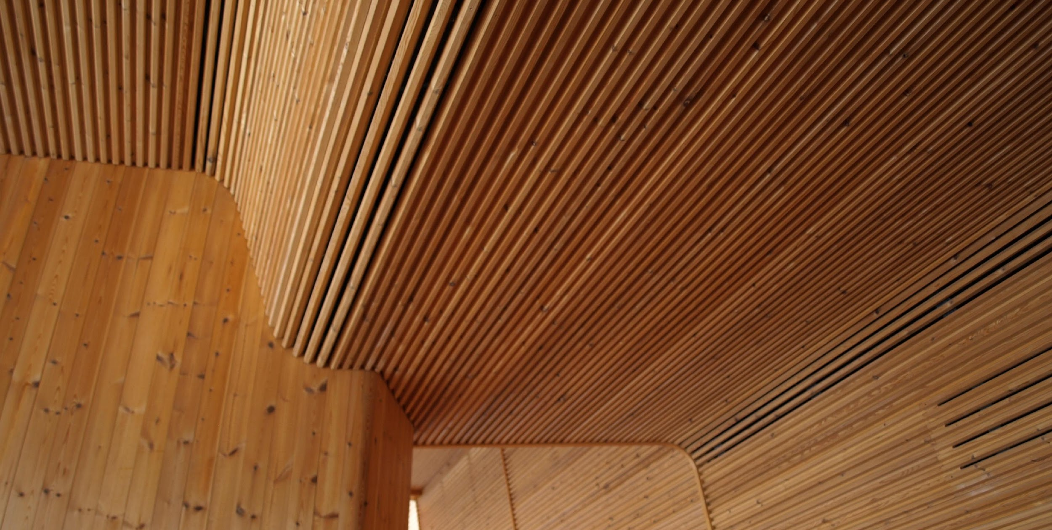
Architectural design

Slide 4
Authors
Markku Karjalainen, Architect D.Sc. (Tech.), Professor
Henri Käpynen, Architect, Researcher
University of Tampere
Release date: 12/05/2022

Slide 5
Architectural design – content
5
Introduction – Wood construction and architecture
Planning and building types from the perspective of wood architecture
land use planning processes, land transfer, building codes, wood architecture and building types
Building regulations from the perspective of wood use in construction
housing design, energy efficiency and thermal insulation, fire safety and sound insulation
Construction processes and the potential of wood at different stages of the construction process
project planning, architectural planning, cooperation with structural planning and HVAC planning

Slide 6
Construction processes and the potential of wood at different stages of the construction process

Slide 7
Contents
Construction processes and the potential of wood at different stages of the construction process
project planning
architectural design
cooperation with structural planning and HVAC planning

Slide 8
Project planning

Slide 9
Project planning
How does a developer see the current state and development potential of an industrial wood construction project?
How does the developer affect the costs of the project and what does the developer's checklist consist of?
Attention should be paid to the choice of project implementation and partners!

Slide 10
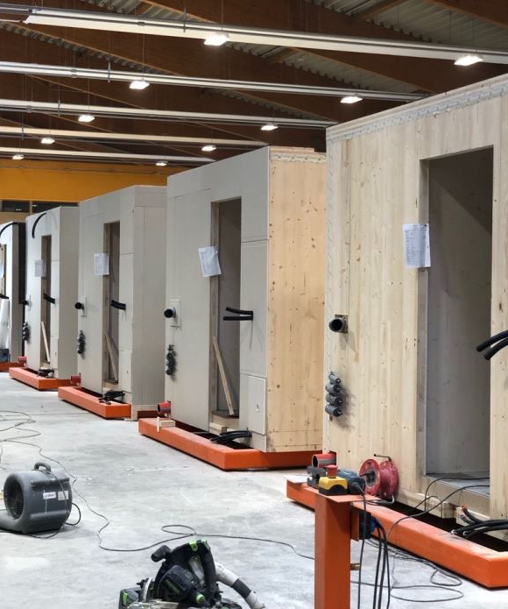
Project planning
The frame system of a wooden building (+ a possible element supplier) should be known and included in the design before the first line of the house is drawn.
From the viewpoint of the customer, ensuring cost awareness and competence in wood construction for all project partners is essential.
All work is completed at the factory and delivered to the site in full truckloads.
The façades, corridors and roof are also designed to be prefabricated and ready to be lifted into place.

Slide 11
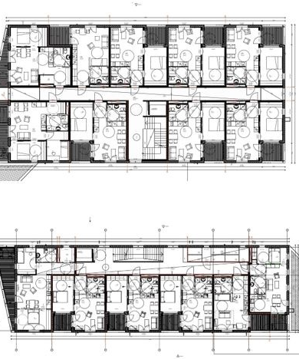
The customer presents their wishes for space distribution and room size
In cooperation with the project operators, the best and most cost-effective compromise is sought, without forgetting the resident and the whole life cycle of the building.
For cost-efficiency reasons, it is desirable to do a lot of repetition in prefabricated unit and housing design.
Wet rooms (toilets and bathrooms) + kitchens are more expensive than dry living spaces (bedrooms, living rooms) > small apartments are relatively more expensive than large apartments because they have a higher relative share of wet rooms.

Slide 12
The customer presents their wishes for space distribution and room size
In cooperation with the project operators, the best and most cost-effective compromise is sought, without forgetting the resident and the whole life cycle of the building.
For cost-efficiency reasons, it is desirable to do a lot of repetition in prefabricated unit and housing design.
Wet rooms (toilets and bathrooms) + kitchens are more expensive than dry living spaces (bedrooms, living rooms) > small apartments are relatively more expensive than large apartments because they have a higher relative share of wet rooms.

Slide 13
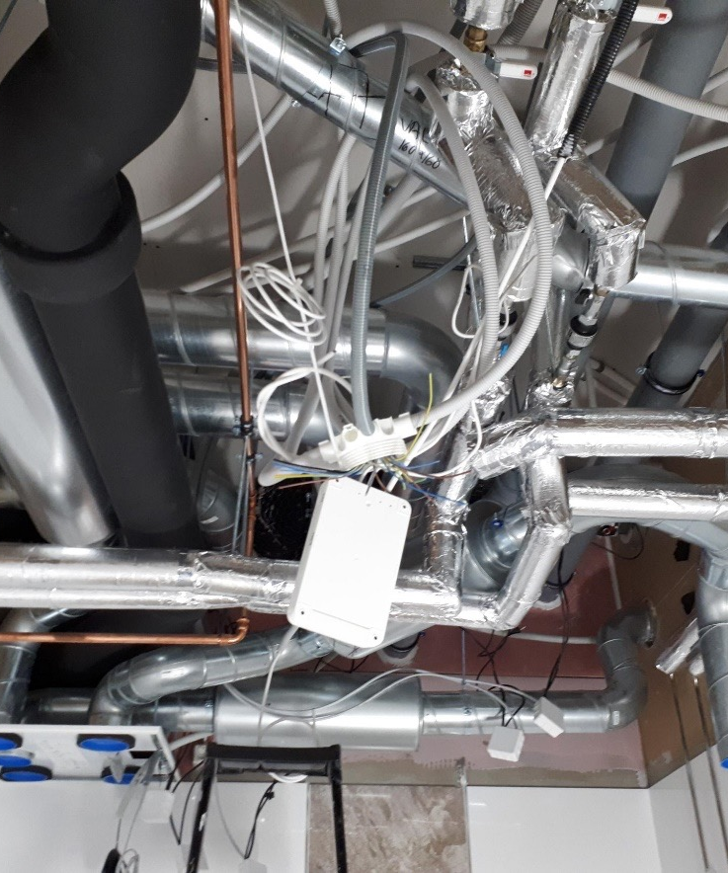
Take the building services routing and installation order + fire and acoustic issues in structural penetrations into consideration
From a cost perspective, it would be desirable for the overlapping floors to have similar layouts. This is also desirable for HVAC duct reservations.
Wet spaces (bathrooms and kitchens) should be placed in such a way, and the routes and installations of building services technology have been carefully thought through to avoid penetrations and difficult sewer installations at both the prefabricated unit factory and the construction site.

Slide 14
There are also specific issues to be aware of in wood construction...

Slide 15
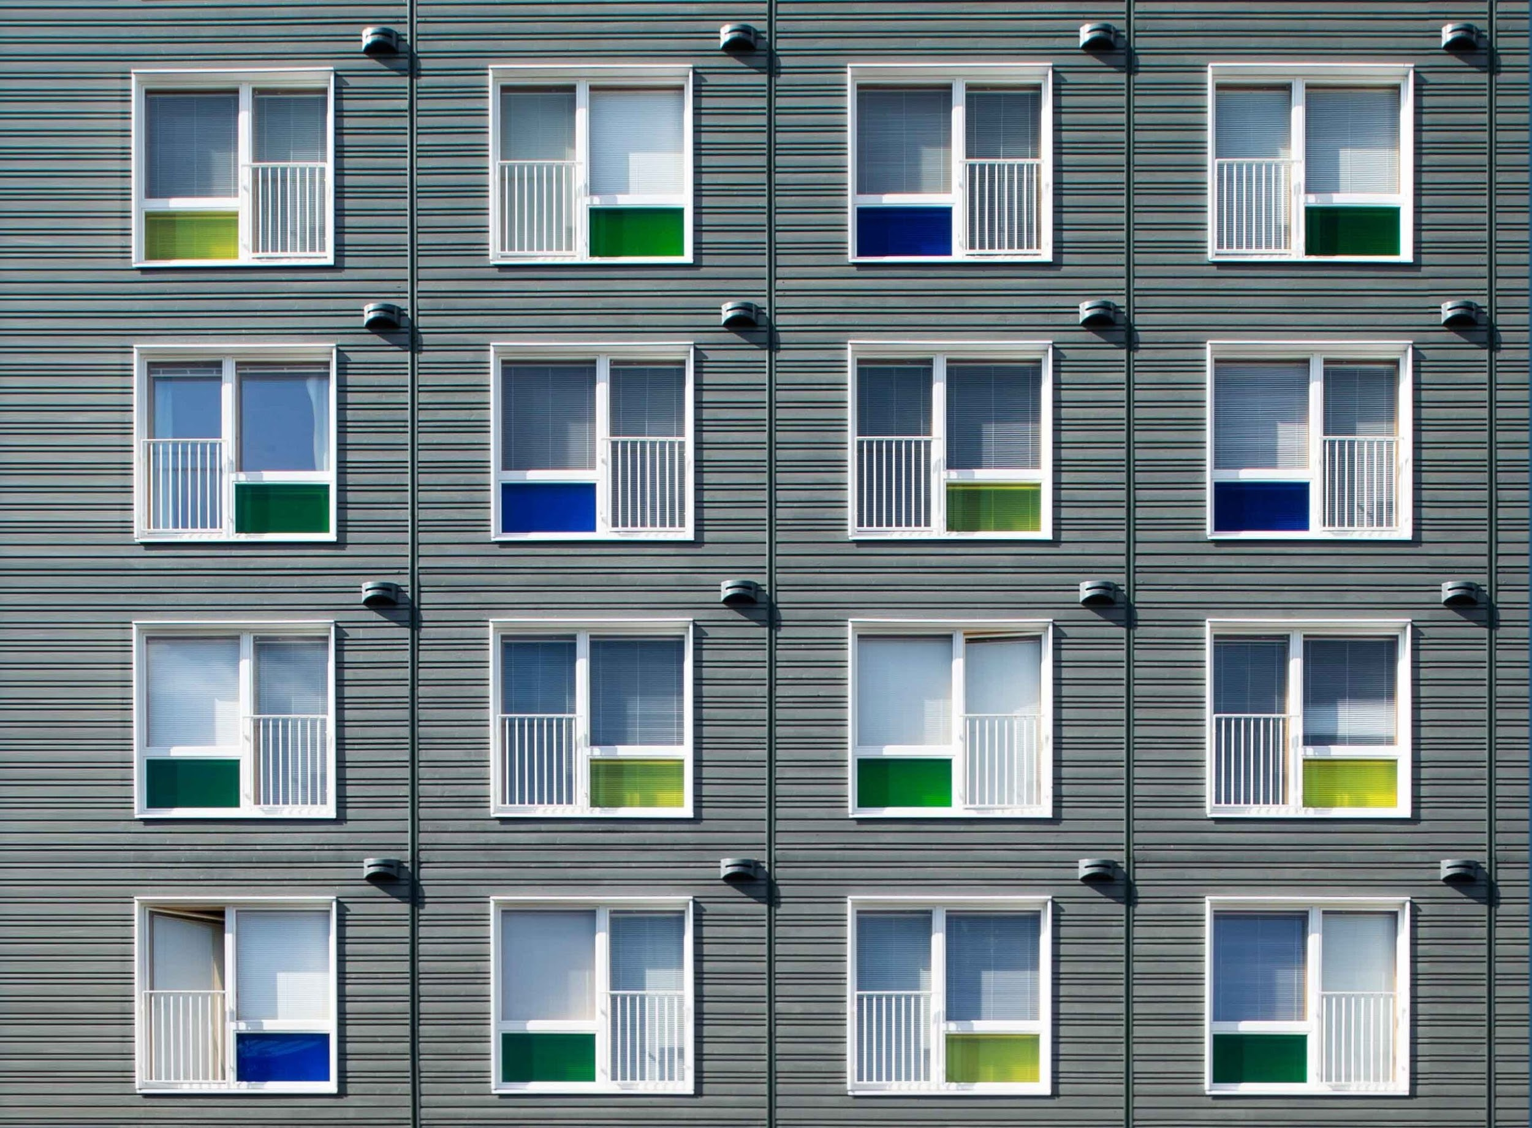
Special relief
In wood construction, you should remember the following "special relief": Section 115 of the Land Use and Building Act “If the thickness of the dividing wall demarcating the apartment is more than 200 millimeters, the floor area of the building may exceed the floor area otherwise permitted for construction by the resulting surface area”
How much does this affect a wooden apartment block?
= 0.5–0.6 m² / apartment on average
A wooden apartment block has an average of 32 apartments >>> 16–19 m² more of residential square metres to be sold or rented!

Slide 16
Examples of projects

Slide 17
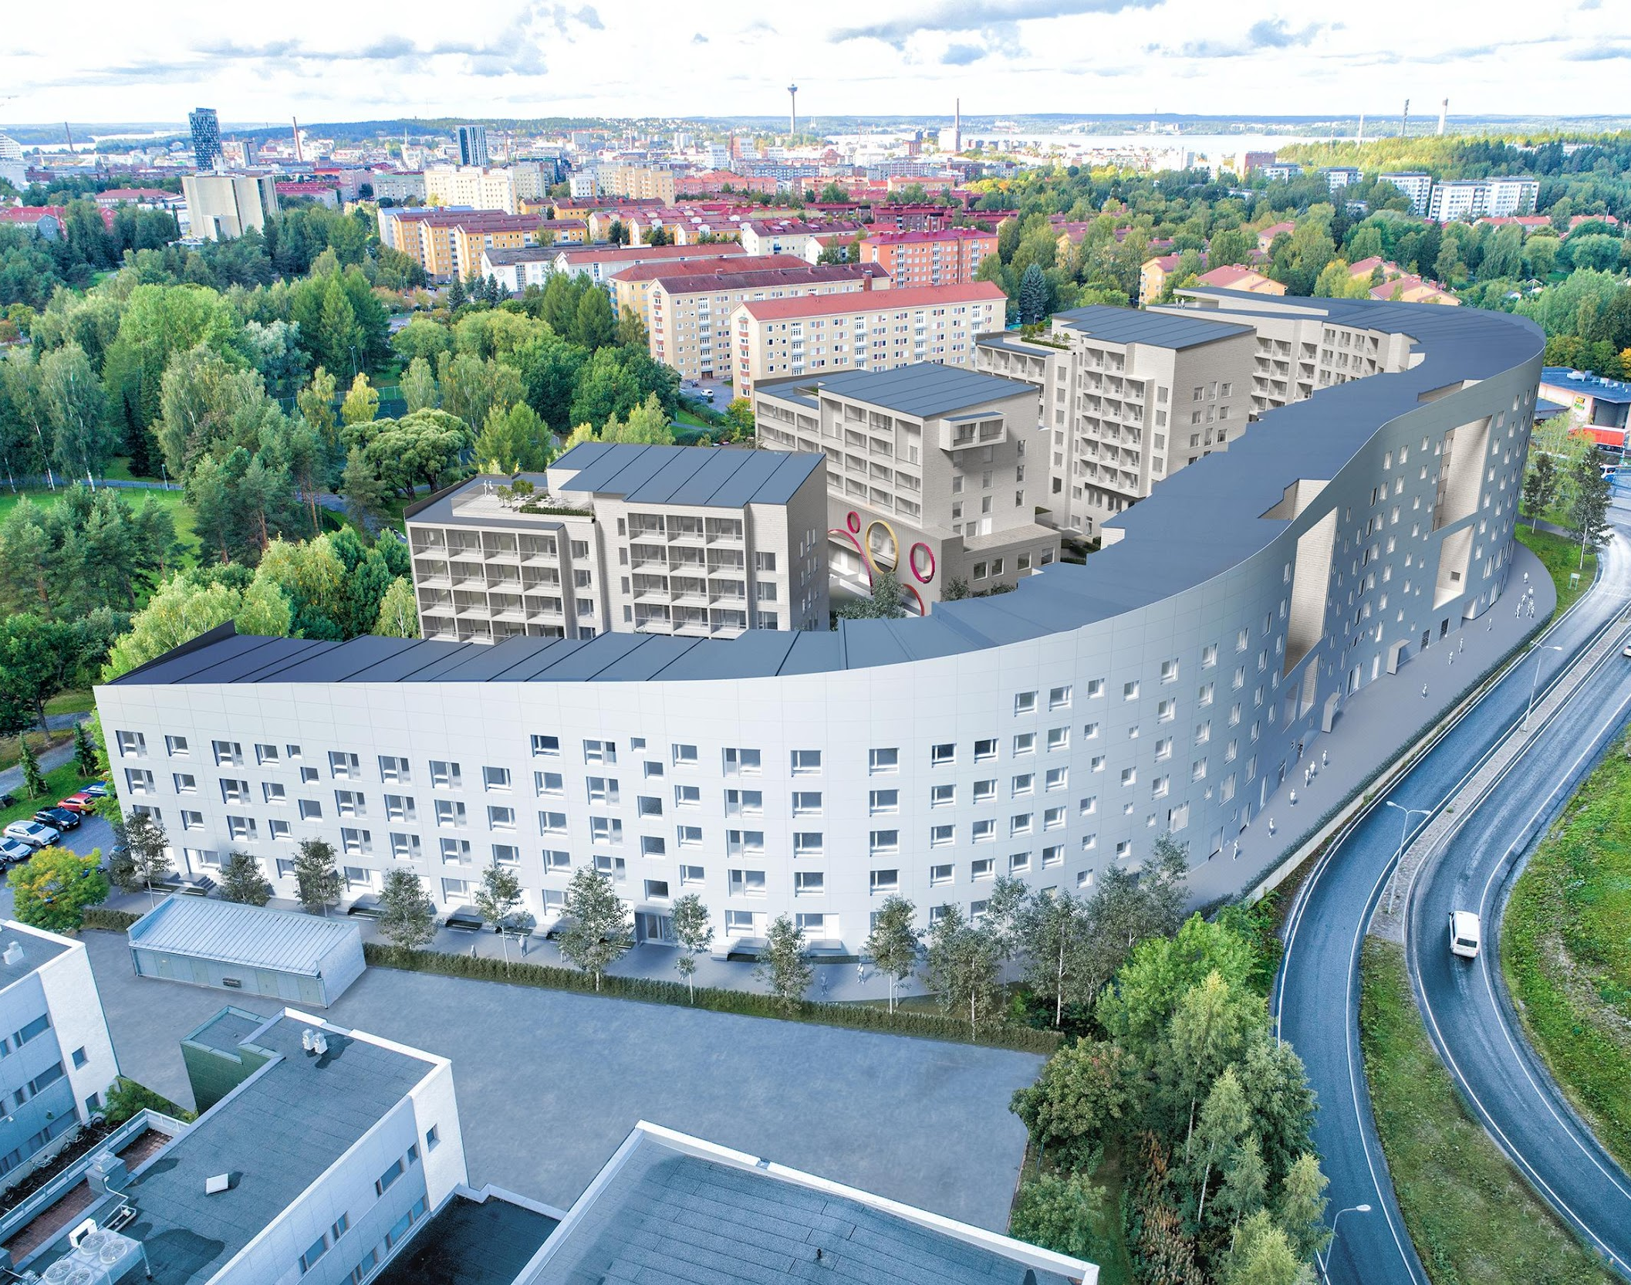
Tampere Student Housing Foundation, TOAS; "Sammon taonta" project
TOAS HIPPOS
Approximately 670 apartments, service and business premises, a shop, a day-care centre
reasonably priced ARA location next to TAMK, Energy class A, RTS
Planning architecture as a result of a invitation competition
Collaborative implementation mode -> Alliance
Solid wood -> modular CLT structure
  COe footprints and handprints
  Life cycle
RTS environmental classification
  Three to five stars?
Takt production
  synchronisation of the entire project
  production time approximately 34 months

Slide 18
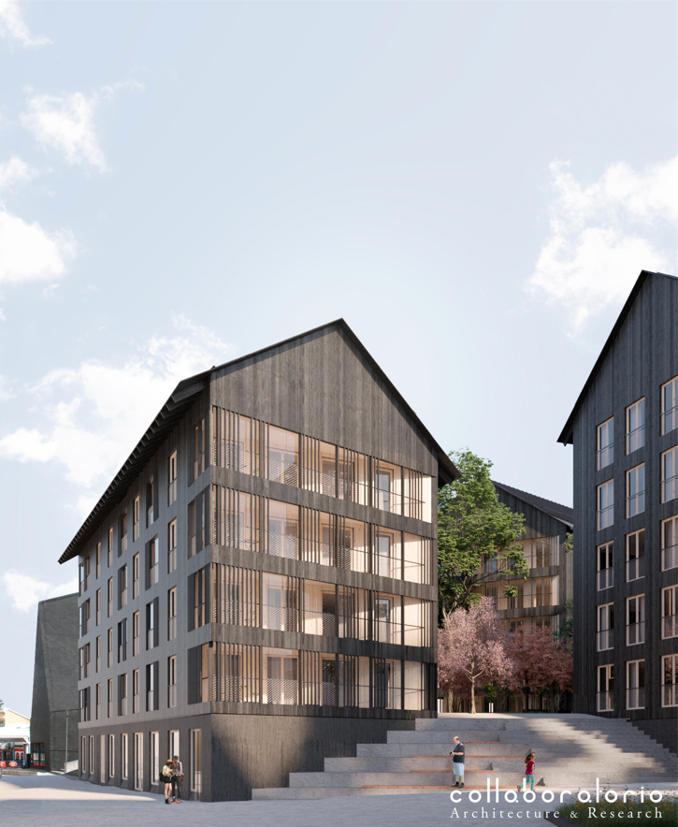
Yrjö and Hanna Foundation sr; "Kolmiloikka" project
Kuokkalan Kalon is the winner of the Housing Reform 2018 competition, and it was designed by the architectural firm Collaboratorio. The project was implemented by the Yrjö and Hanna Foundation sr and JVR-Rakenne Oy
Start of construction 12/2021
Project themes
  industrial wood construction,
  block as a service platform,
  communal and
  multigenerational block
5 buildings, 165 apartments
  right of residence
  senior rental housing
  dementia-friendly rental living
  non-subsidised

Slide 19
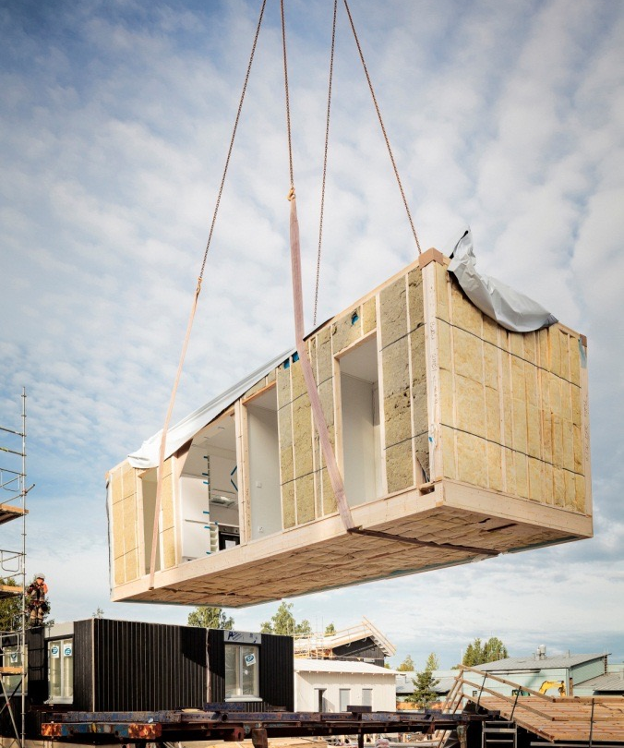

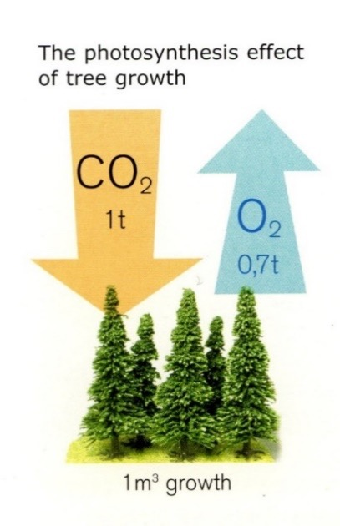
Responsibility; for the environment, comfort and cost levels
Responsibility throughout the life cycle of the site is at the heart of the project.
In the name of ecology, the customer has chosen wood construction as the starting point for both "Tuottavuusloikka" projects, and industrial prefabricated construction as the implementation method.

Slide 20
Cooperation with structural planning and HVAC planning

Slide 21
Ventilation
It is recommended that the engineering and utility services space of a wooden apartment block be placed in a basement, where a ventilation unit is also placed. It is recommended that the HVAC vertical ducts are placed in the stairwell in the duct zone. The residual air is led out through the wall or, alternatively, onto the roof.

Slide 22
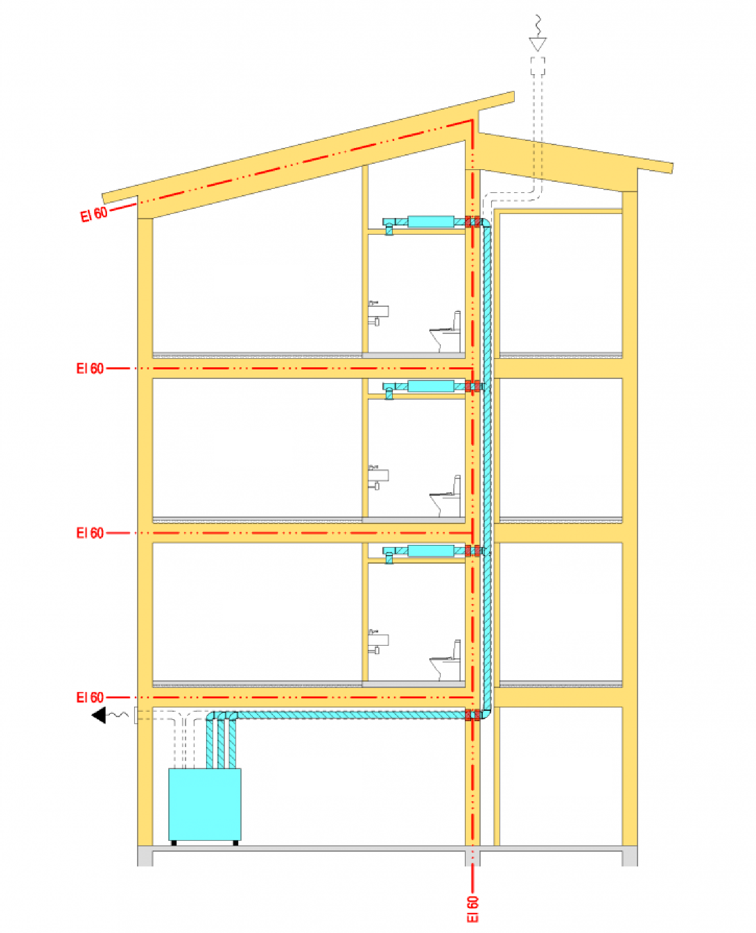
Ventilation
Flat
Stair well
Flat
Stair well
Flat
Stair well
Engineering and utility services room
Stair well
Ventilation
machine

Slide 23
Water pipes
The water pipes risers are installed in the stairwell. From the lower ceiling of the stair well, the water pipes are connected to the pipe connections of the prefabricated wet room units of the apartments. In this way, any water leaks in the riser can be easily detected and the pipelines can be repaired. Pipe lead-throughs are not made in the intermediate floor structure of the apartments. All connecting lines in the apartments are plastic pipes installed inside a protective tube.

Slide 24
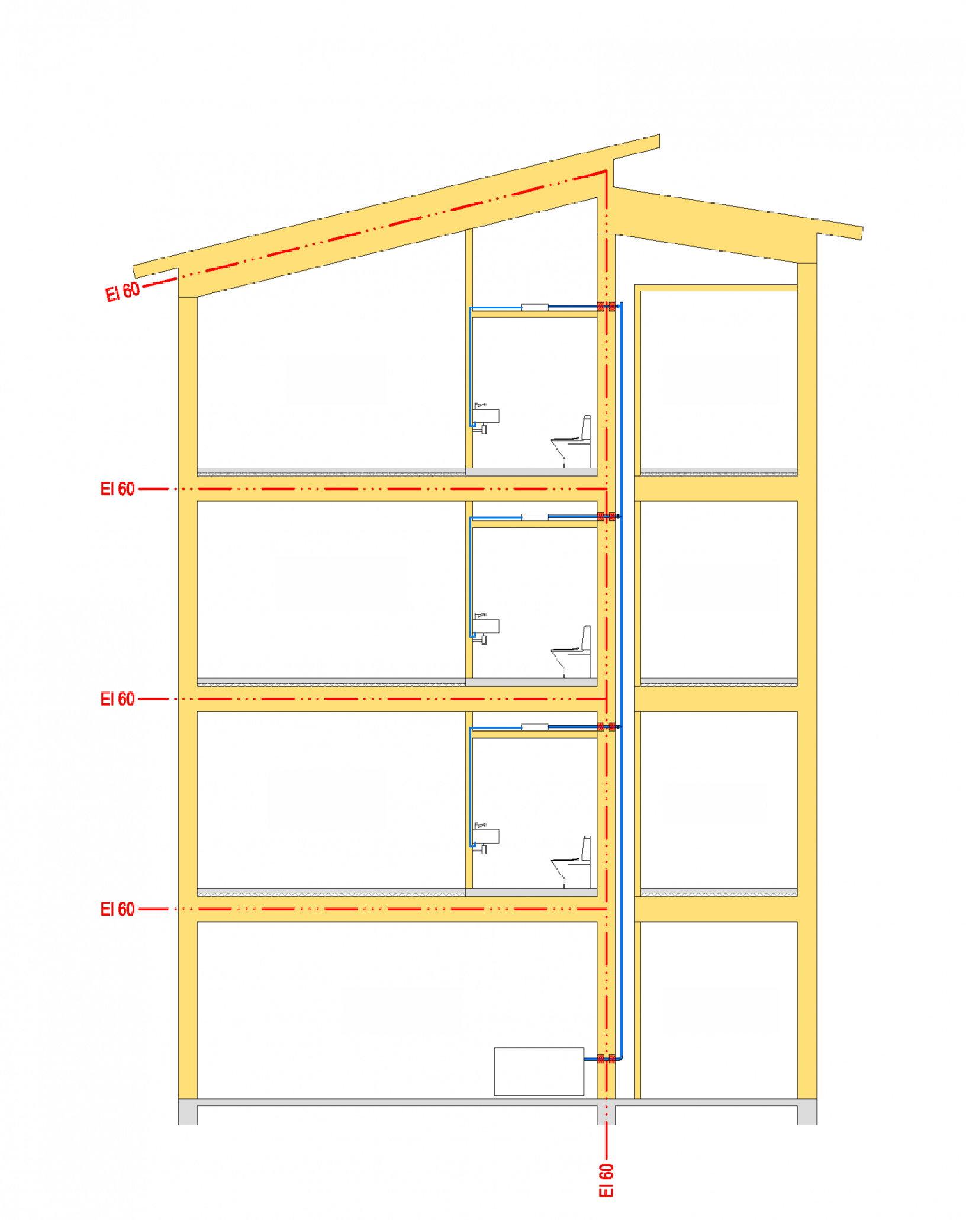
Water pipes
Flat
Stair well
Flat
Stair well
Flat
Stair well
Engineering and utility services room
Stair well

Slide 25
Drains
It is recommended that the wet rooms are placed on the wall opposite the stair well. It is possible to connect the pipes through the wall directly to the vertical ducts, thus reducing the harmful effects of drainage noise. Removing the toilet drain from the floor structure reduces the nuisance of drainage noise and the need for a drain connection is completely avoided.

Slide 26
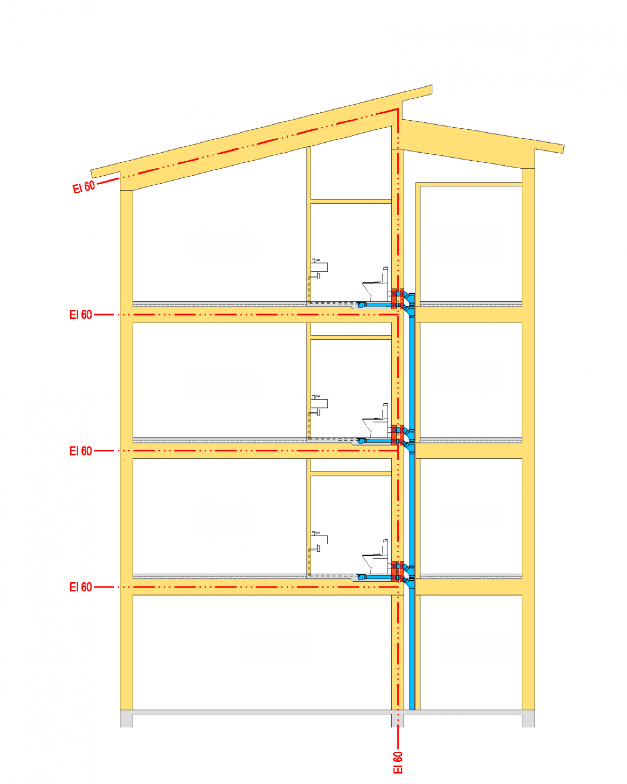
Drains
Flat
Stair well
Flat
Stair well
Flat
Stair well
Engineering and utility services room
Stair well

Slide 27
Literature

Slide 28
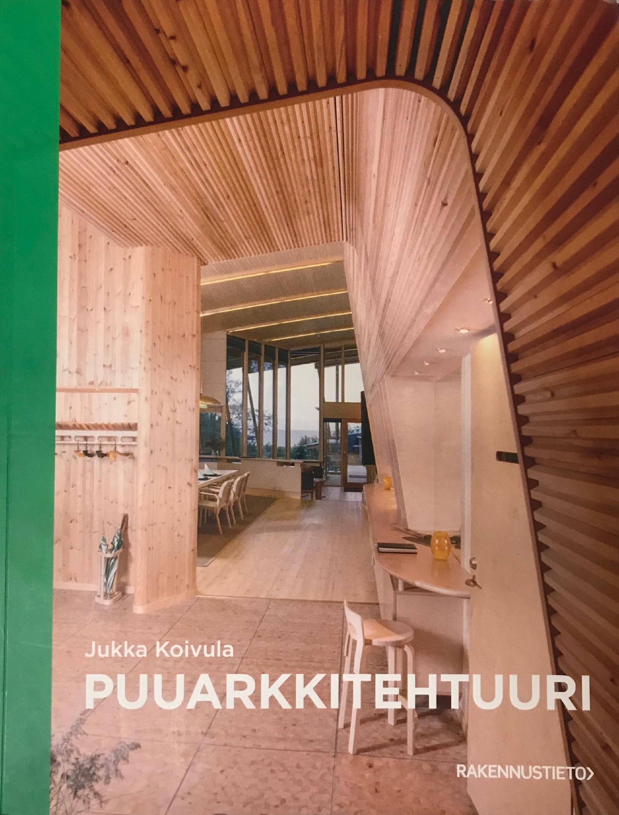
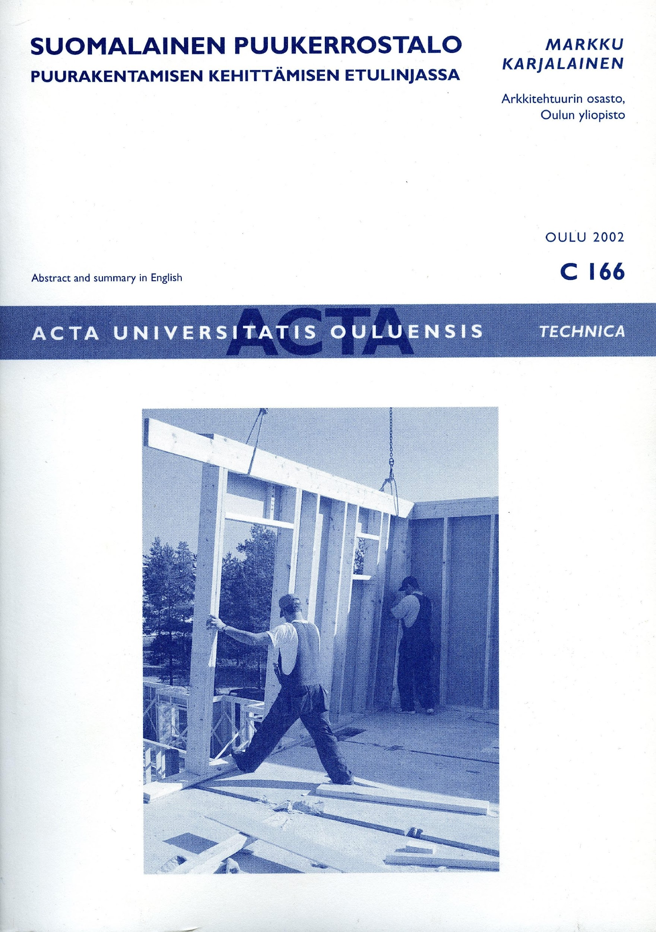
Publications

Slide 29
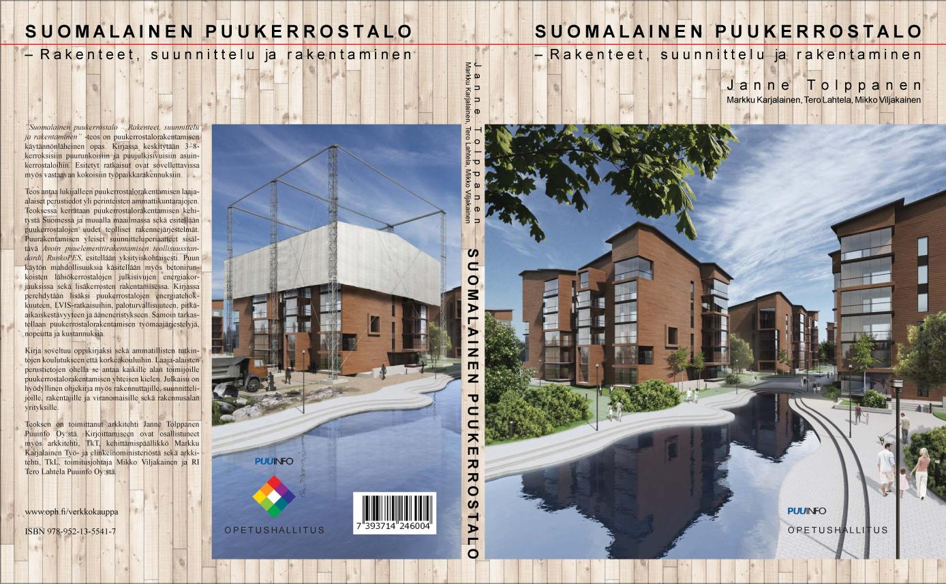
Publications

